Slide 1

Health Needs Assessment
Refugees from Ukraine
Steve Morton
Health Improvement Programme Manager
Healthy Places, Wider Determinants, Levelling-Up & Health Inequalities Lead
April2023

Slide 2
HNA Suite of materials
Full Technical Report
Summary Report
Summary of Recommendations
PowerPoint Presentation

Slide 3
Contents
Remit
Background
Methodology
Literature Search
Participant data
Key Findings
Differences & Commonality with other refugee populations
Recommendations

Slide 4
Remit
Assess and describe the health needs of people arriving from the Ukraine,
Especially those who have been here several months with initial sponsorship in northwest England
Review data on underlying morbidity issues, health status, health needs, cultural preferences, and measurable wider determinants, then analysing and interpreting this to advise policy.
Aims its recommendations at the Northwest England regional, system and local level forums in local government and health.
The content of the recommendations considers the differing needs, demands, financial and political climates
Support decision makers, policy leaders and system leaders to inform prioritisation, resource allocation and rationing decisions in health and other service delivery by taking a pragmatic and politically astute approach at regional, system and local level.
Determine priorities for future development and research areas, including identifying potential funding sources for research.
The target audiences are Local Authorities (Public health, housing, education, members), NHS (NHS E, ICBs, PCNs),OHID, UKHSA, Strategic Migration Partnership.

Slide 5
Background
Russian invasion of Ukraine 24 Feb 2023
Over 10 million refugees and 8 million internally displaced (UNHCR)
UK government predicted approx. 200k refugees arriving in UK
Two main schemes established for Refugees entering the UK
No HNA has been carried out in England
Numbers entering via Homes for Ukraine are published by LTLA
Previous migrants have experienced cultural and access to healthcare issues

Slide 6
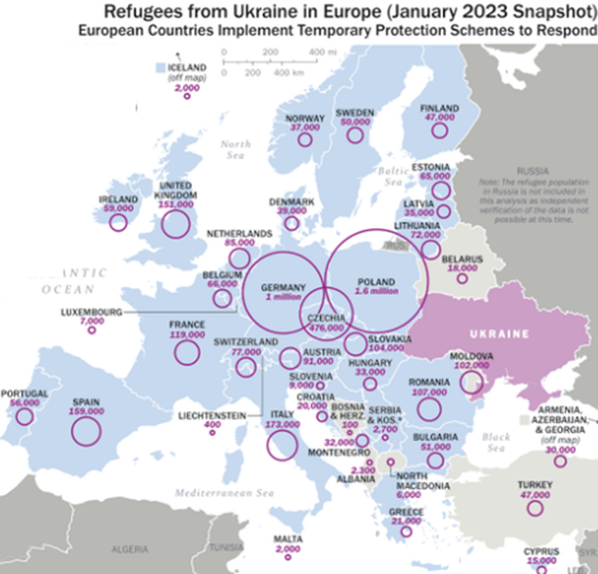

Slide 7
Methodology
Key Consultees
• Association of Ukrainians in Great Britain
• Cumbria Supports Ukraine
• DHSC Ukraine Team
• Homes for Ukraine Lancashire
• Kalyna Ukrainian Community
• Lancashire Refugee Integration Team
• Liverpool PCN
• Liverpool City Council Public Health, Emer Coffey
• Morecambe Bay Teaching Hospitals NHS Trust, MORRA Project
• North West Strategic Migration Partnership
• Dr Aaron Poppleton
• Rooms for Ukrainians NW
• Sponsor, Accommodation & Jobs for Ukrainians Group
• UKHSA, Tanith Palmer
• Ukrainians of Manchester
Web and grey literature
Stakeholder engagement
Literature Review
Survey
Analysis
Recommendations
Publication & Dissemination
All data up to Feb 2023
Survey Jan-Feb 2023

Slide 8
Literature Search
1. 2014 to December 2022 (to represent and align with the timing of the annexation of Crimea by Russia) = 35,867 document results
“Ukraine” OR “Ukrainian” OR “refugee” OR “migrant” AND
"health need" OR "health" OR "medicine" OR "medical"
OR
"mental health" OR "stress" OR "depression" OR "post traumatic stress" OR "PTSD" OR "anxiety" OR "isolation"
OR
"physical health" OR "communicable disease" OR "infection*" OR "chronic disease"
OR
“social" OR "access" OR "integration" OR "culture" OR "housing*" OR "education*" OR "care"
2. Only UK and English language articles = 4718 document results
3. Other languages = Excluded
4. Restrict to social sciences, medicine, nursing, immunology, health professions, multidisciplinary, and dentistry = 4136 document results
5. Restrict to articles, book chapters, government guidance and conference notes = 3406 document results
6. Limit to 2022 (Russian invasion of Ukraine) = 2555 document results
7. Sort on relevance. Review abstract and title of top 250 results = 115 results
8. Review of full text of documents = 85 results

Slide 9
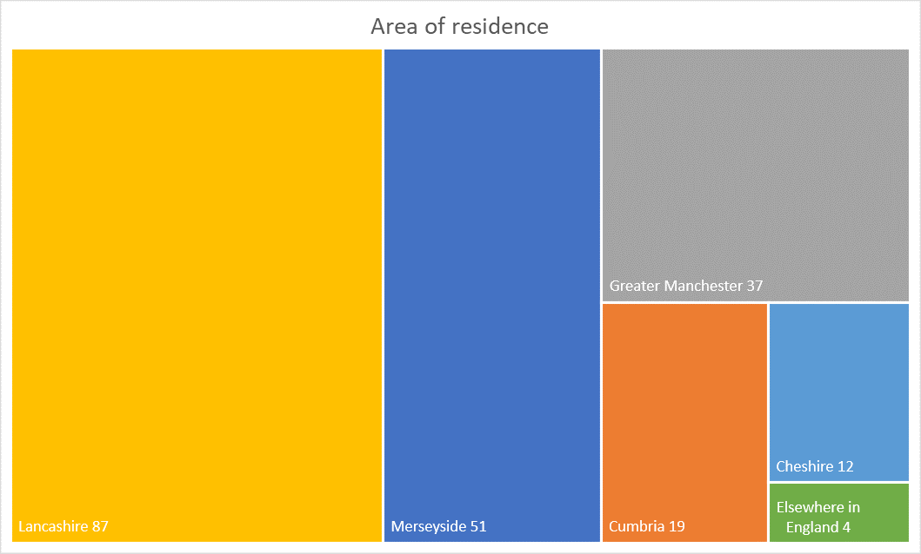
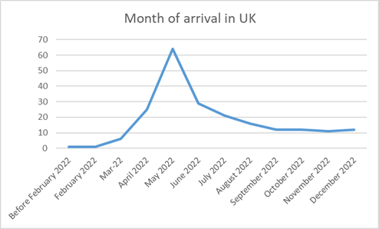
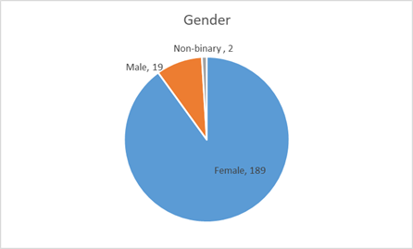
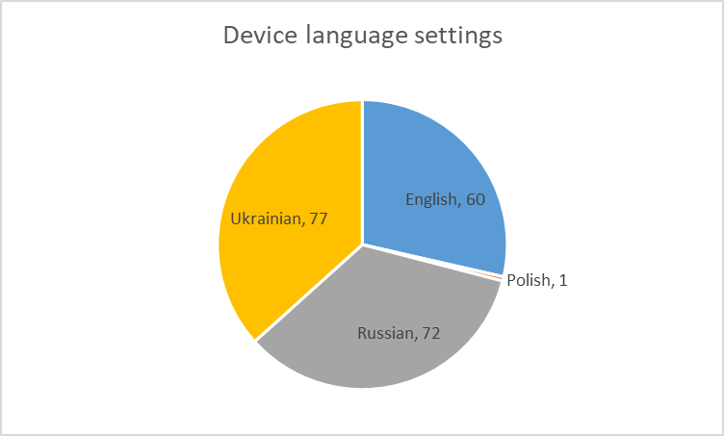
Survey participant data

Slide 10
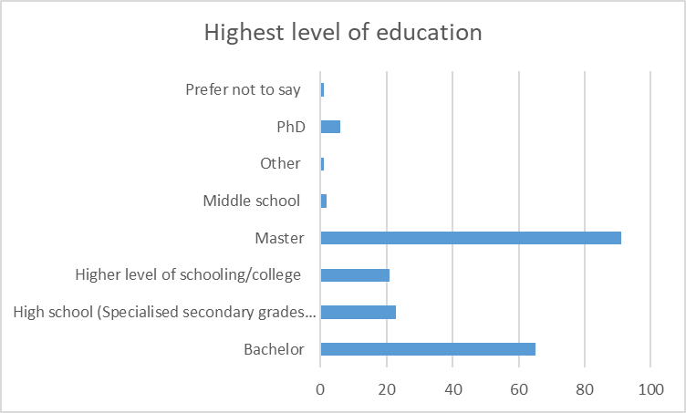
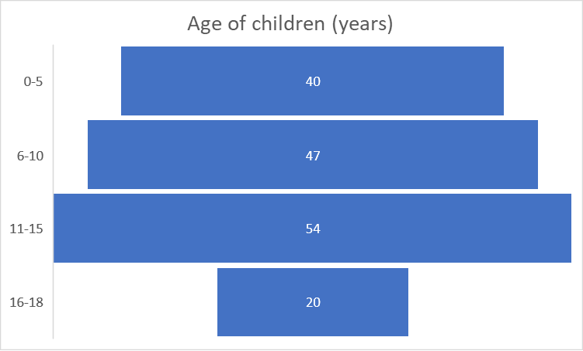
Demographics Key Findings
Average age = 35 years 1 month

Slide 11
General Health Findings
Refugees report a decline in their personal health standards since arriving in the UK.
The focus group established that although their health had declined, they felt that it would have been a lot worse had they remained in Ukraine.
Key reasons for the decline in health were;
Concern for those back at home
A fear of the unknown
Being disorientated in a new country
Language difficulties
PTSD and other mental health issues as a result of the time they left Ukraine
Concerned about their child’s education and development
Difficulties in navigating the health system in the UK
Loneliness (missing loved ones)
Changes in diet
Changes in water and air quality
Digestive issues
Skin complaints thought to be due to changes on types of employment (factory work and food prep)
Muscular and Skeletal disorders brought about by carrying out manual labour rather than usually doing deskwork.

Slide 12
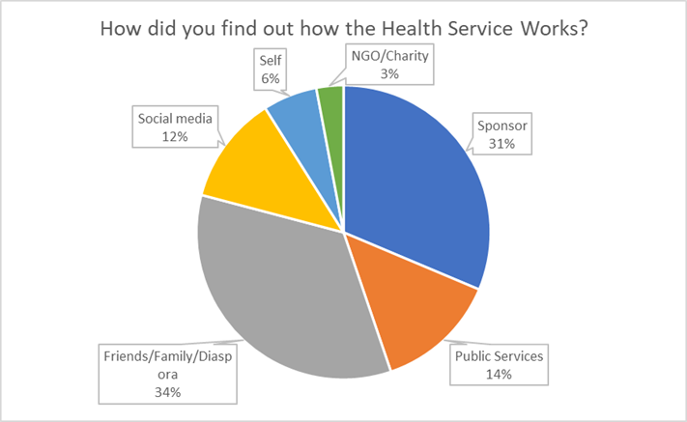
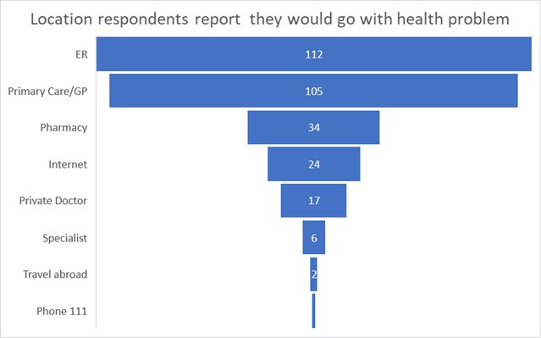
Access Findings
Vast majority have registered with a GP. However, anecdotal evidence suggests that recent influxes of asylum seekers do not re-register when they move/are moved, will refugees act similarly?
Discussions at both the focus group and MORRA workshop indicated that migrants are experiencing similar difficulties in accessing primary care as many native population report. However, migrants feel that they are being excluded, being made to wait longer for an appointment and misunderstood.

Slide 13
Access Findings
Refugees had experienced considerable procedural, cultural and language difficulties in accessing NHS services, especially General Practice.
Only mid-level trust in health professionals in England (63.7%).
Cultural dismissal of the UK ‘gatekeeper’ GP role.
It is likely that this perception is a consequence of the high level of education and home income of those who have travelled to the UK.
Concern was greatest in relation to paediatric health care. Belief that children should be prioritised and see paediatricians.

Slide 14
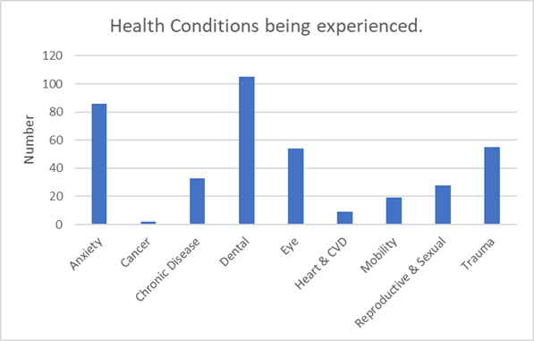
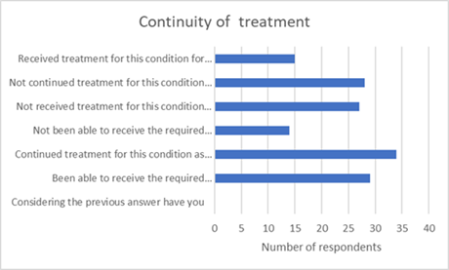
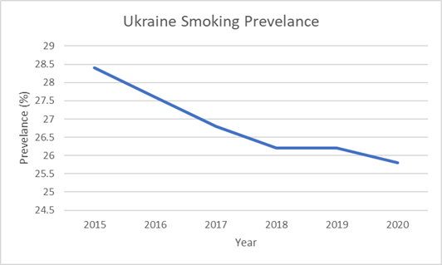
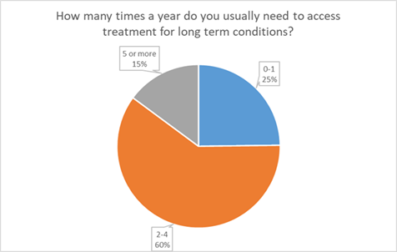
Existing Conditions Findings
Drug addiction in Ukraine has its peculiarities, it has a group character in Ukraine.
Opium poppy straw extract continues to be the main drug of choice.
Marijuana is growing in popularity among young people and use of synthetic drugs is appearing with increasing frequency.

Slide 15
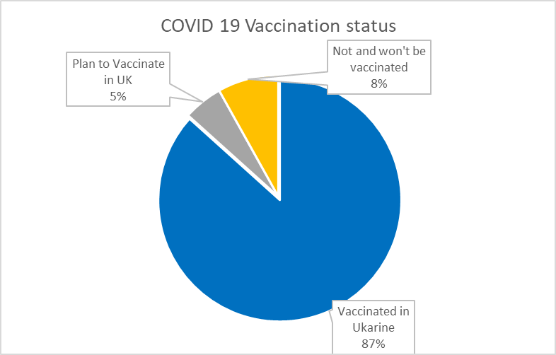
Infectious Diseases Findings
Low rates of vaccination
Diphtheria-Tetanus-Pertussis
Polio
Flu (Influenza)
Measles-Mumps-Rubella (MMR)
COVID-19
Hepatitis B
BCG (for those under 16)
Ukraine has one of the highest rates of Multi Drug Resistant Tuberculosis the world (27%). The 4th highest globally. It also has the 2nd highest total TB incidence rate.
AMR rates are much higher than in the UK. This includes MRSA (18-38%)
High rates of STIs including HIV

Slide 16
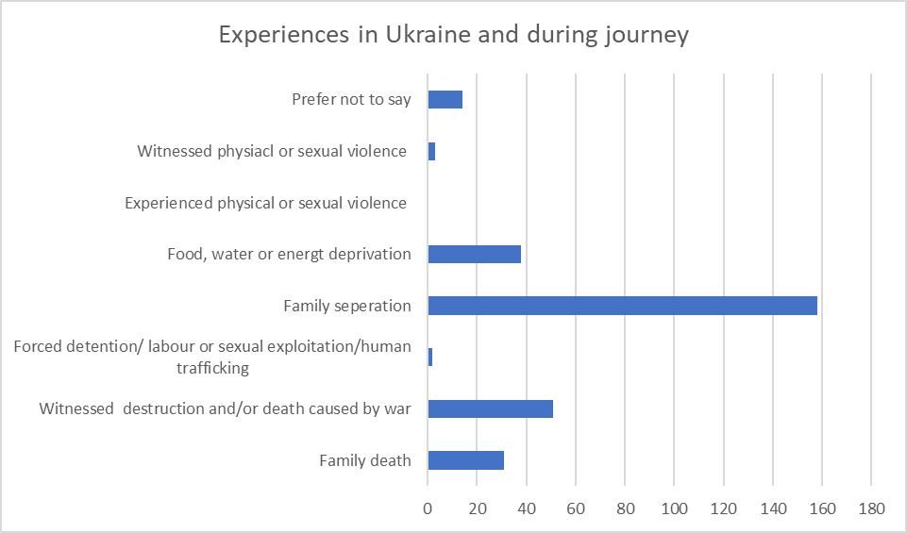
Trauma Findings
Health professionals and UNFPA have recorded more premature births, hypertension problems during pregnancy or non-pregnancy-related conditions such as uterine prolapse amongst women refugees leaving Ukraine
Three of the 210 participants reported witnessing physical or sexual violence, two reported experiencing forced detention/ labour or sexual exploitation/human trafficking. This indicates that refugees arriving in north west England from Ukraine may require support relating to such experiences.

Slide 17
Oral Health Findings
Considering the relatively low levels of Oral health in Ukraine pre-war, we can assume a need for dental health services on arrival in the UK.
To determine possible needs for dental services whilst in the UK, survey participants were asked when they last saw a dentist.
70% had seen a dentist within the preceding 24 months in Ukraine,
5% had received dental treatment within five years in Ukraine
A further 44 refugees from Ukraine had already visited a dentist in the UK.
This would indicate that those refugees who had come to north west England had better access to dental care in Ukraine than the average population and consequently, should have better oral health.
9% were experiencing oral pains that kept them awake, indicating potential serious conditions including abscess, infection and oral cancer.

Slide 18

Experience Findings

Slide 19
Experience Comments
“I do not receive the treatment that I received in Ukraine.”
“I feel better in the UK, because I don’t hear explosions. Sometimes I’m scared of fireworks.”
"I feel excluded from the NHS care in the UK. In Ukraine I used to have hight standard of medical care and support by the free government medical service. “
“GP found good medication for my blood pressure level”
“I had perfect health before arriving in the UK. After 2 months being in the UK I started to have severe migraines and asked for the MRI diagnostics in June 2022, Now January 2023 and I still have no appointment given by NHS, my needs Ignored.”
“I prefer to treat my teeth in Ukraine. It is cheaper and more quality.”
“I think mentally it is still very difficult to go through what I am going though even though I’ve been in the country for almost a year now…”
“I think that medical system of England is like in Africa. Especially dentists. Education and their abilities is very bad.”
"Sexual health care is much better here. Dental care is very bad and impossible to get. It is very accessible and high quality in Ukraine."

Slide 20
Wider Determinants Findings
Initial housing agreement is for 6 months only
Some have been extended
Some have been relocated
Some have been placed in hotels etc
There is a risk of homelessness
Many Ukrainian Community Support Hubs to support new residents upon arrival to the local community.
The hubs are often a central place to come to get items refugees may need when they arrive (clothes etc), and to get the information and support to help them to settle in the UK.
They provide a safe space to integrate with other Ukrainian families who were fleeing their homes during Russia's invasion of their home country.

Slide 21
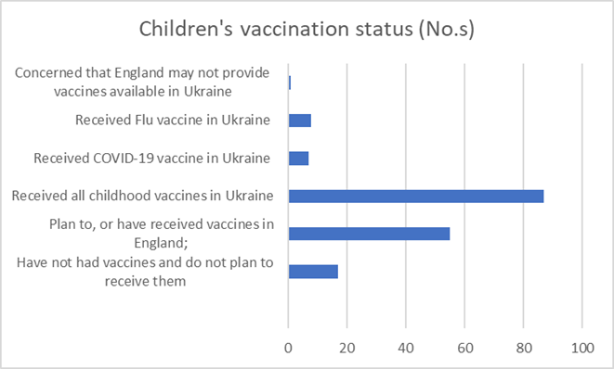
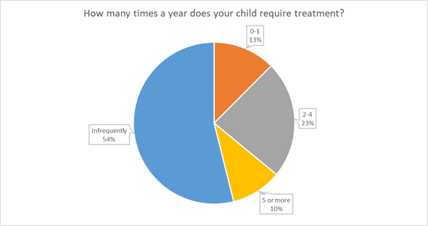
Children’s Health Findings
Of the 210 who responded to the survey, 35 reported that they brought children with long term conditions with them to the UK. Nine stated that they had children with disabilities.
Overall, the children who have arrived are reported to be in generally good health. When asked how often their children needed treatment only 59 said they received medical treatment in any one year

Slide 22
Differences & Commonality with other refugee populations
Language
Culture
Access
Disorientation
Need for guidelines
Education
Affluence
Position in society
Predominantly female
More children
GP Gatekeeping

Slide 23
Recommendations
This report includes several the recommendations to the health care system, local authorities, government departments, voluntary sector, and universities. Ukrainian refugees consulted recommended that there should be;
Support for community liaison/champion/navigator type roles
Better explanation of how the health system works at an early stage prior to and immediately on arrival
Quicker and easier access to translators/mediators
Improved cultural competence amongst clinical staff including the social and cultural aspects of refugees

Slide 24
Recommendations
Additionally, the report identifies further recommendations to address;
Improved screening
Regular refresher training for staff
Housing insecurity
Societal education
Improved welcome packs
English Language lessons
Sexual Health screening
Improved targeted psychological support
Adopting a Trauma Informed Approach
Commission and carry out further research in relation to
  Cultural Competency Training
  Benefits of hosting refugees
  Effectiveness of Community Champions

Slide 25
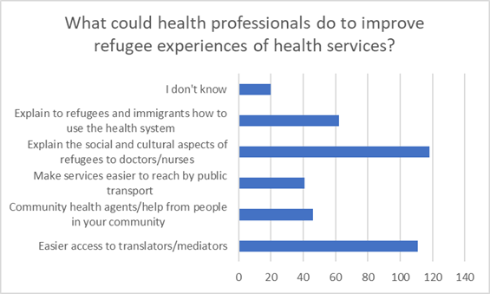
Stakeholder recommendations

Slide 26
Access to Health Care

Slide 27
Health Care 1

Slide 28
Health Care 2

Slide 29
Child Health

Slide 30
Wider Determinants

Slide 31
Wider Determinants 1

Slide 32
Wider Determinants 2

Slide 33
Limitations
There are a number of limitations that need to be taken into consideration in reviewing this HNA.
Data on refugees arriving via any means other than the Homes for Ukraine Scheme is not available at Local Authority level. Therefore, the local picture of refugees is not as detailed as it could be, missing some individuals from the total population figures.
Data on asylum seekers at upper or lower tier local authority level is not publicly available to protect their confidentiality, and therefore was not used in this report. Therefore, the local picture of asylum seekers is not as detailed as it could be.
GP data could not be interrogated as the current systems do not record whether a person is a refugee.
Although 210 is a good number of respondents and is a substantial cohort of the total number of Ukrainians arriving in the North West, the total number of respondents is relatively low. This may limit the validity of the data received.
The respondents to the survey would by the very nature of having taken part be engaged in local developing communities or be IT savvy. This may not be entirely representative of those who have arrived in the UK and may introduce an element of selection bias in favour of better educated individuals. This was in part mitigated by holding a focus group and carrying out interviews with agencies working with refugees.

Slide 34
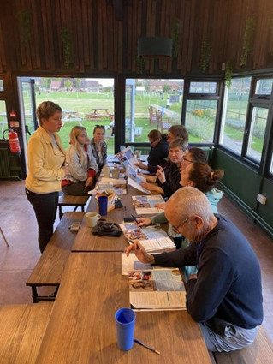
Questions

Slide 35
List of Abbreviations and Acronyms
Abbreviation/Acronym | Full text
AS | Asylum Seeker | AMR | Anti-Microbial Resistance
DBS | Disclosure & Barring Service | CMO | Chief Medical Officer
DLUHC | Department for Levelling Up, Housing and Communities | DHSC | Department of Health and Social Care
DWP | Department of Work & Pensions | HNA | Health Needs Assessment
ICS/P/ | Integrated Care System/Partnership | GP | General Practitioner
LGA | Local Government Association | HEE | Health Education England
NCDs | Non-Communicable Diseases | NIHR | National Institute of Health Research
NGO | Non-government organisation | MSF | Medecins Sans Frontieres (Doctors Without Borders)
ONS | Office of National Statistics | OHID | Office for Health Improvement and Disparities

Slide 36
List of Abbreviations and Acronyms Continued
Abbreviation/Acronym | Full text | Abbreviation/Acronym | Full text
NW RSMP | North West Regional Strategic Migration Partnership | RCPCH | Royal College of Paediatrics and Child Health
PCN | Primary Care Network | PTSD | Post-Traumatic Stress Disorder
Section 95 | Housing and financial support to a person who has claimed asylum | SCOPUS | Elsevier’s abstract and citation database
UKHSA | UK Health Security Agency | TB | Tuberculosis
UNICEF | United Nations International Children’s Emergency Fund | VCSE | Voluntary, Community and Social Enterprise
WHO | World Health Organisation | UNHCR | United Nations High Commissioner for Refugees

