Slide 1

Social Value
James Hunter
Head of Strategic Procurement
STAR Procurement
(t): 0161 912 1616
(e): procurement@star-procurement.gov.uk
STAR Procurement is the shared procurement service for Stockport, Trafford, Rochdale and Tameside Councils

Slide 2
Social Value
The Social Value Portal
Social Value Submission
Themes, Outcomes & Measures (TOMS)
Examples of Delivery
Qualitative Response
GM Social Value Framework
Local Priorities
Contract Management Process
Do’s & Don’ts
FAQ’s/Top Tips
Resources
Any Questions

Slide 3
Social Value
The Social Value Portal:
An accounting methodology for measuring the benefits of SV.
Provides a contract management tool to manage SV throughout the life of the contract.
Enables the contractor to evidence their outcomes live on the portal - for future bidding/case studies.
Converts commitments into metrics to demonstrate value / impact to communities.
The measurements link to Themes, Outcomes and Measures (TOMs) - a nationally developed tool.
Notes:
GRACE –

Slide 4
Social Value
Social Value Submission
Bidders are required to complete the following as part of their tender submission:
A quantified Social Value proposal; and
A qualitative (method) statement
Thematic Approach
Delivery Capability
Engagement and Collaboration Plan
Quantitative score: [10%] of total question score
Qualitative score: [10%] of total question score
It is important that bidders should be confident of their ability to deliver Social Value proposals made, as the Council will contractualise these commitments with the winning bidder which will then be monitored and reported on periodically.
Notes:
GRACE -

Slide 5
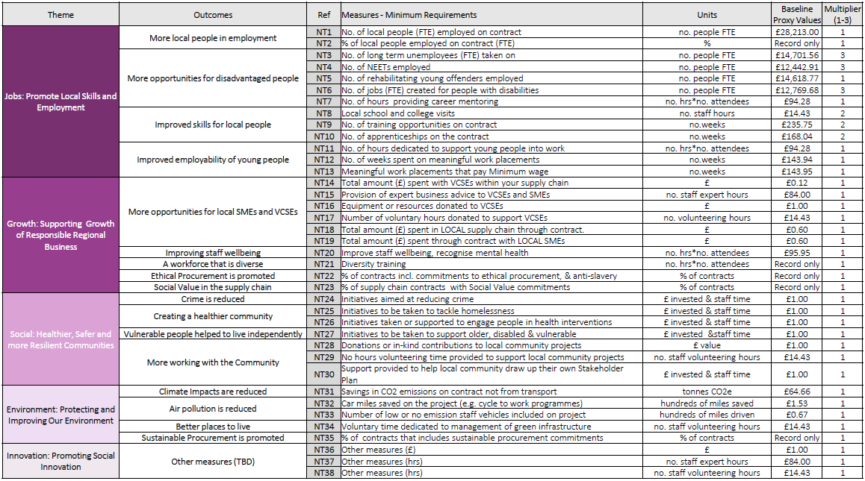
Social Value
Themes, Measures & Outcomes (TOMS)
Notes:
GRACE -

Slide 6
Social Value
Qualitative Response
A. Thematic Approach
Please set out below your methodology and approach under each Social Value Commitment and explain how you will contribute to the delivery of sustainable Social Value outcomes.
This section should make reference to each TOMS outcome you submit on the Social Value Portal
B. Delivery Capability
This section should cover:
An identified single point of contact and their role in the delivery of the Social Value outcomes AFTER award;
Your approach to monitoring, measurement, and reporting Social Value outcomes for the duration of the contract.
C. Engagement and Collaboration Plan
This section should explain how you will engage with relevant stakeholders and delivery partners on the delivery of Social Value

Slide 7
Social Value
GM Social Value Framework
Provide the best employment that you can
Keep the clean air in Greater Manchester
Create the employment and skills opportunities that we need to build back better
Be part of a strong local community
Make your organisation greener
Develop a local, GM-based and resilient supply chain

Slide 8
Social Value
Tameside Local Priorities
Resilient Families
Very Best Start in Life for Young People
Opportunities for People to fulfil potential
Sustainable Environment
Nurturing Communities
Good Mental Health
Independence in Older Age

Slide 9
Social Value
Case Studies
Notes:
Good – Left, Bad - Right

Slide 10
Social Value
Contract Management Process
The Social Value Portal should be used quarterly/annually to input achieved social value
The SVP will chase providers/suppliers for incomplete or late reporting
Key Performance Indicators (KPI’s) may be included in the contract and will be treated the same as any other contractual KPI’s
Contract Managers/Commissioners will monitor these performance indicators on a Quarterly/Annual basis depending on requirements
Social Value Portal will send Quarterly/Annual Social Value Reporting Progress to Contract Manager.
Contract Managers may manage performance if KPI’s not being met utilising the contractual clauses where applicable

Slide 11
Social Value
Do’s | Don'ts
Do be confident in your ability to deliver the SV proposals you’ve made. | Don’t offer anything that is required in the core contract.
Do make sure your SV offer relates only to this opportunity | Don’t double count!
Do provide Good Evidence of how you will deliver your SV offers | Don’t leave your social value submissions until last minute – timing is key!
Do include committed local spend as part of your supply chain
Notes:
EMILY -

Slide 12
Social Value
Most frequently asked questions
How do we download the bids?
What happens if there is double counting?
How do we approach Clarifications with Bidders if bids are too low and too high
Who ensure Social Value is delivered?
What happens if the winning bidder doesn’t deliver their targets?
External
What type of evidence do you require us to submit
Are Social Value targets annual or total values
I’ve submitted TOMS pre covid pandemic that I cannot deliver.. What do I do?

Slide 13
Social Value
Resources
Here is a short video which will demonstrate how to navigate and use the portal hopefully of some use!
https://www.youtube.com/watch?v=zVTQITBqu8s
Notes:
EMILY -

Slide 14
www.star-procurement.gov.uk
Any Questions
Notes:
GRACE -

