Slide 1
Moving On Tameside 2020
Donna Graham| Operational Manager| Positive Steps

Slide 2
Understanding the Landscape
Oct 2020 – Close to previous levels of Employment, Education and Training destinations for young people in Tameside. However we know that the full effects of COVID 19 are yet to be seen.
Recent estimates - projected an 80% reduction in apprenticeship opportunities, a 10% -12% reduction in national GPD and 15% reduction in Greater Manchester’s GDP.
Delivery - We have developed virtual careers guidance, resources and advice for all pupils, maintaining contact throughout the entire pandemic and contacting every pupil at transition age to assess their needs.
Support - Online careers sessions, helplines for young people and families to support their wellbeing as well as careers choices, Social media
World of work - Virtual work placement events have been facilitated to ensure young people still have access to the world of work.
Learning - determined not to lose the learning from these innovations
It is clear that face to face contact can’t be replicated for many without losing the essence of good guidance and support/A mixed economy of virtual and physical engagement is the preferred method from most young people.
Partnership working is going to be the cornerstone of effective support, now more than ever

Slide 3
Introduction
Moving On highlights progress of young people at Year 12
Focus is on NEET and unknown
Linked to Gatsby, RPA
Both school and local authority are accountable for destinations
Snapshot on a specific day of pupils progress and transition
Destination of young people following exit from school

Slide 4
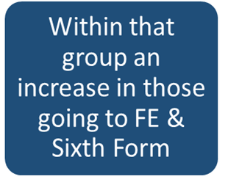
Highlights
Tameside Young People
High in learning figures across all ethnic groups
The NEET figure has fallen from 3% to 2.5% which includes 3 people awaiting a start date
The Participation figure is up from 96% to 96.4%

Slide 5
Challenges
LAC participation figure of 89.6% is down on last year’s figure of 95.8%
Fall in those going into Apprenticeships
SEND The Participation rate of 90% is lower than last year’s 92.5%

Slide 6
What’s next for Destinations and Moving On?
Ongoing destination measures
National Research
Data and consent

Slide 7
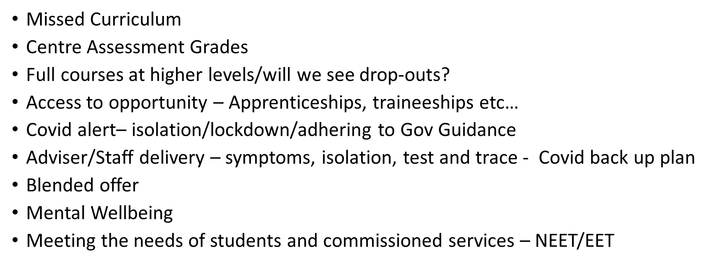

Slide 8
Director Young People’s Services: Paul Axon
paulaxon@positivesteps.org
Service Lead - Career Guidance & Support Services: Kelly Baxendale
kellybaxendale@positive-steps.org.uk
Operational Manager Tameside – Donna Graham
donnagraham@positive-steps.org.uk
Service Lead – Management and Systems Support – Phil Collinge
philcollinge@positive-steps.org
Oldham Office: 0161 621 9400

