Slide 1
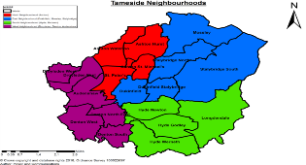
EARLY HELP/EARLY YEARS & NEIGHBOURHOODS

Slide 2
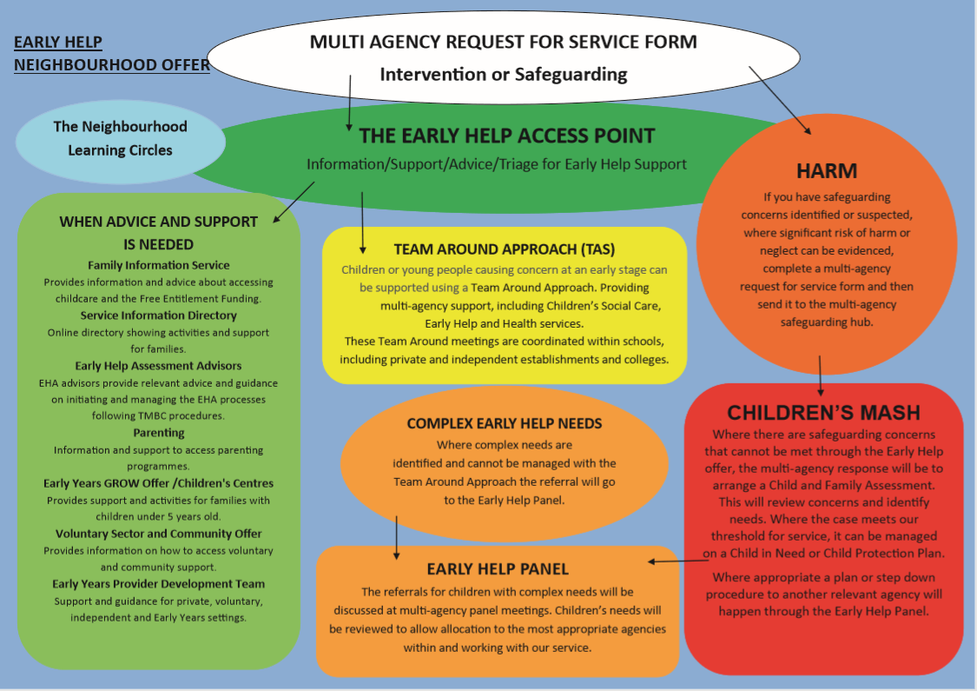

Slide 3
Early Help Pathways
Early Help Access Point – 342 4160
Team Around
Early Help Panel
Early Help Assessment Advisors
Early Years/ Children Centres
Parenting
Provider Support
Families Information Service / Service Information Directory
Health Young Minds (SPOE)
Family Intervention
Action Together
Neighbourhood Offer
Pathway straight to the Women's Centre too

Slide 4
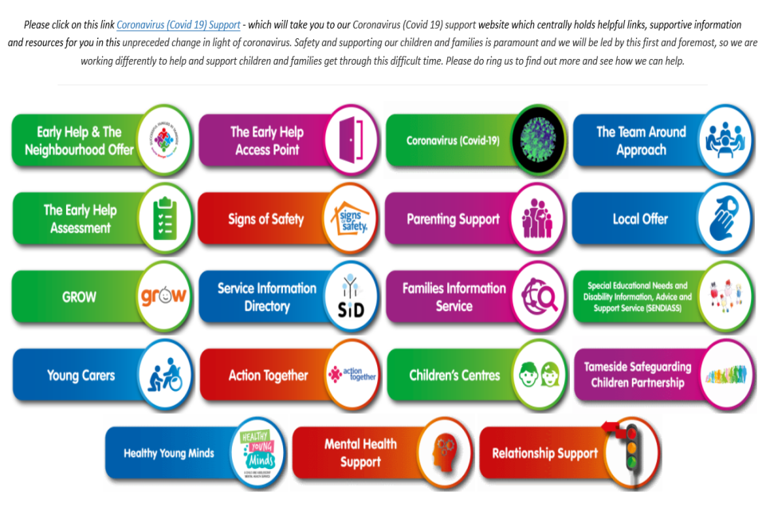
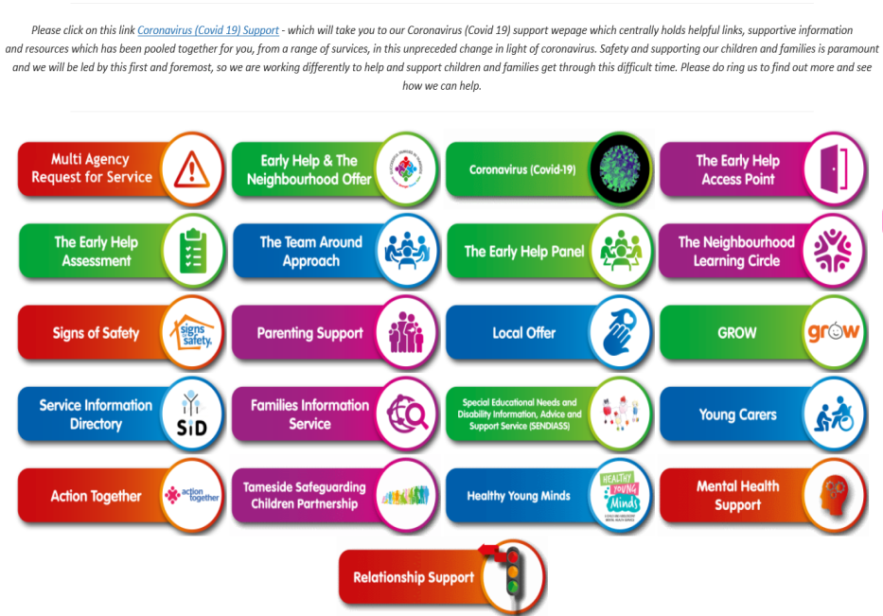
EH/NEIGHBOURHOODS WEBSITE https://www.tameside.gov.uk/earlyhelp/neighbourhoods
Over 20k HITS!

Slide 5
Early Years Offer
Early Years and Children Centres
4 designated children’s centres, one in each locality in Tameside.
Following COVID we now have a blended offer both virtual/ online offer and some face to face for targeted groups. We align our EY offer with Health / midwifery and Voluntary sector and deliver through the GM 8 stage model
Currently universal offer for Grow Early Years
•Live Rhyme Time session every Monday
•Lockdown Babies group Every Thursday
•Book of the week is promoted on the Facebook Page weekly, this includes various activities across the week.
•Early Years Helpline (being launched)
•Baby Babble (zoom)
Targeted Offer
•Communication Pathway, Zoom session & access to virtual Facebook page, allocated key worker for each family for support, pre & post Wellcomm assessment completed.
•Physical Pathway – virtual offer, key worker system, post ASQ for assessment.

Slide 6
Early years continued
Early Years Quality Improvement Team
The Early Years Quality Improvement Team provides support, advice, guidance and training to all early years’ practitioners who are required to deliver the EYFS Statutory Framework, (EYFS) within Tameside.
The remit of the team is to work in partnership with early years practitioners (all PVI’s and schools) to raise standards and quality within the early years sector, as well as increasing the good levels of development across Tameside and in turn supporting better outcomes for all children across the borough.
The Early Years Quality Improvement consists of 8 Early Years Quality Officers who offer specialist support to Private, Voluntary, Independent settings, schools, Childminders and Children Centre’s within Tameside.
Portage
The Portage Service is part of the Early Years Offer in Tameside. The Portage Team have links with the Integrated Service for Children with Additional Needs (known as ISCAN).
Portage offers tailored sessions which are designed to help children to develop through play with support from various services and their parents/carers.
Families are visited on a regular basis, weekly, fortnightly or monthly usually at home by a Portage worker
Visits usually last between 1 to 2 hours
The Portage Team are trained early years professionals who have a wide range of experiences working with children and families
The Portage worker brings along a selection of toys for a fun play session
During these sessions parents/carers are encouraged to join in and share the child’s likes and dislikes and any concerns they have regarding their child’s development
The Portage worker may use a variety of assessment tools to help identify strengths and areas to work towards. The child’s progress is regularly reviewed
The emphasis is on the positive—what the child can do. Each session is tailored to meet the family’s individual needs

Slide 7
SENDIASS
Our service provides information, advice and support to children and young people with Special Educational Needs (SEN), and those with Disabilities, and their parents/carers (who have children/young people aged 0-25 years).
Confidential and impartial information, advice and support to children, young people and their parents/carers on education matters and health and social care matters in relation to education.
Information, advice and support on subjects including local policy and practice, personalisation, personal budgets, preparation for adulthood, the law on SEN and Disability, Health and Social Care.
Information, advice and support throughout the Education, Health and Care (EHC) needs assessment process and review process.
Information, advice and support about SEN Support in settings, schools and further education.
Support in preparing for and attending meetings.
Help in filling in forms and writing letters/reports.
Support in resolving disagreements, including Disagreement Resolution, Mediation and Tribunals.
Signposting to other local or national sources of advice, information and support.
Links to local parent support groups and forums.

Slide 8
PARENTING OFFER
Parenting Strategy
Parenting Courses
Parenting Clinic
Parenting Helpline
Training Offer
Tools and Resources
YOUNG CARERS
Referrals and Assessment
Group Support
One to One support
School Support
How are we working differently in Covid?

Slide 9
STARS (Strengthening Tameside’s Approach to Repeat Removals)

Slide 11
STARS Partners

Slide 12
Contact Details
lorraine.hopkins@tameside.gov.uk
Head of Service
emma.lewis@tameside.gov.uk
Service Manager
rachel.Berrisford@tameside.gov.uk
Team Manager

