Slide 1
PLACING CLOSER TO HOME
Nick Ellwood – Contract and Commissioning Officer

Slide 2
Background
The Council has a statutory duty to ensure that there is sufficient accommodation to meet the needs of looked after children in their community.
Statutory guidance makes it clear that children should live in the local authority area, with access to local services and close to their friends and family, when it is safe to do so.
The guidance emphasises that ‘having the right placement in the right place, at the right time’, with the necessary support services such as education and health in place, is crucial in improving placement stability, which leads to better outcomes for looked after children.
In an ongoing response to this we have been looking closely and reviewing all of our agency placements.
Ensuring that our providers have the up to date plan for each individual child

Slide 3
We have also been reviewing our internal processes e.g. Placement finding and tracking
Trialling innovative ways of reviewing cases
We have a weekly placement panel now that provides governance for placement requests and tracking.
It also ensures that placement referral documentation has relevant and up to date information.
We are reviewing all our plans to ensure that we have an accurate picture of our permanency requirements.

Slide 4
Tameside Picture (Residential)
Tameside has the second highest number of our children in residential placements in GM
Around 40% of our children in agency residential placements live outside their home local authority area and more than 20 miles from their home community
Tameside has 33 children placed outside the borough in children’s homes
The average distance for these placements is around 70 miles from Tameside
This has a significant impact on our children who have not been able to live in their home community
Children who have had 3 placements are more likely to live far away

Slide 5
Tameside Picture (Fostering)
We have 155 children placed with agency Foster Carers
This is around 56% of our ‘In-house’ total
The average distance for these placements is around 17 miles from Tameside
There are about 18 Children (12%) that are 30+ miles away - the other 80% are in neighbouring areas.
About 50 Children (32%) are actually in Tameside

Slide 6
Tameside Picture (SAILS)
We have 91 Young People placed with a Semi Independent agency provider
40 Young People (44%) are placed outside of Tameside but in the Greater Manchester area.
3 Young People are placed further than this.
Furthest is Shropshire around 80 miles away

Slide 7
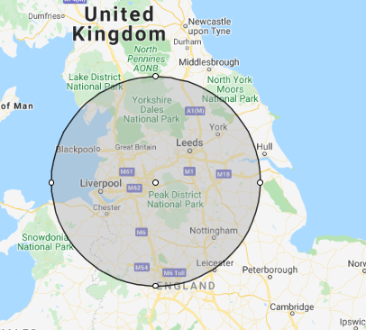
Average distance of 70 miles

Slide 8
What do we want to change
We want our children to live in good services in, or near to, Tameside unless it’s not safe to do so
We want to build good quality working relationships with local providers
We want to work in partnership to deliver quality services
Want to work with services to support our children to move successfully into family environments or on to independence

Slide 9
How we want to do it
Have regular engagement with local provision who want to take our children – we have started by establishing monthly meetings with a local provider who takes lots of our children – we want to expand this.
Have local providers tell us about when they are going to have vacancies coming up so we can try and plan placing our children with you when it’s appropriate
Problem solve together in our regular dialogue,
have open and constructive conversations about our local pressures
Act on challenges in practice/ working together you have identified
Support the development of quality services
Embed Coproduction into our practice – and work together to coproduce services - LISTENing in Tameside.
Working with other Greater Manchester authorities, who also have the ambition to place more children ‘close to home’
‘Build back better – covid coping

Slide 10
Our ask:
If you are interested in working in this way, let us know when we email you following the event if;
You have a genuine interest in working with us to increase the number of our children living in Tameside
Have a genuine desire to work together to improve the services for our children
There’s no commitment in exploring working in a new relationship and it’s not ‘one size fits all’
We know this is a long term way of working. Effective partnership working will take time and the ‘proof will be in the pudding’

