Slide 1
COVID-19 Update
Provider Forum
Charlotte Lee, Population Health Programme Manager
James Mallion, Public Health Consultant
Friday 19th February 2021

Slide 2
Today’s session
Covid-19 Update;
Update on testing;
Update on Contact Tracing Guidance;
Delivering the infection prevention control key messages to reduce impact on children’s settings;
Community Champions.

Slide 3
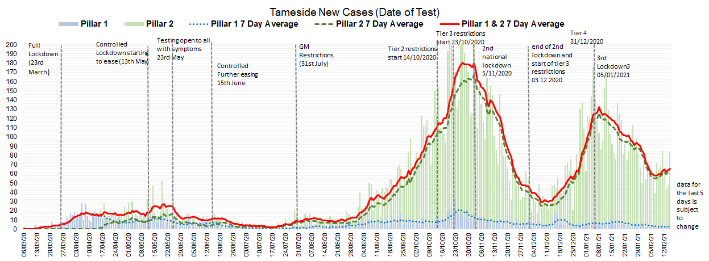
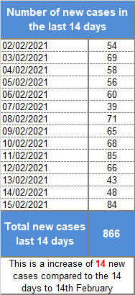
Trends in New Cases for Tameside (15/02/2021)
Current rate of new cases in the last seven days per 100,000 people is 202.7/100,000
The current rate is a 11% increase compared to seven days ago
Tameside currently ranks 4th in GM for new cases in the last 7 days
This data comes from locally available data source which can be more up to date than the published data and is subject to change

Slide 4
COVID-19 Update
The new variant of COVID-19 represents over 80% of new cases in Tameside now and is the dominant strain.
The new variant is much more transmissible so spreads more easily, but is still transmitted through droplets – so the same controls still work and are even more important.

Slide 5
Covid-19 Update
The main symptoms of coronavirus are:
a high temperature – this means you feel hot to touch on your chest or back (you do not need to measure your temperature)
a new, continuous cough – this means coughing a lot for more than an hour, or 3 or more coughing episodes in 24 hours (if you usually have a cough, it may be worse than usual)
a loss or change to your sense of smell or taste – this means you've noticed you cannot smell or taste anything, or things smell or taste different to normal
Some people report different symptoms but these are the main ones – anyone with concerns about their symptoms should get tested.

Slide 6
Testing Update – The Key Messages
With symptoms:
If anyone has symptoms, including staff or children, they should isolate along with all household members and those with symptoms book a PCR test - https://www.gov.uk/get-coronavirus-test or call 119.
Isolate until the results are known. If positive – continue to isolate for 10 days from the onset of symptoms.
There are 2 permanent sites in Tameside for a PCR Test - Darnton Road, Ashton and Beeley Street, Hyde.
Without symptoms (asymptomatic):
Staff as key workers as eligible for lateral flow testing (LFT), with results in 30mins.
There are 2 sites in Tameside for a LFT – Stalybridge Civic Hall (9-5pm) and Dukinfield Town Hall (7-7pm).
No need book – drop in offer - https://www.tameside.gov.uk/rapidtesting
Recommended that staff are tested twice a week – 3 to 4 days apart.
Do not go for a LFT if you have symptoms or are currently isolating.
If staff get a negative LFT result – it is important other control measures are maintained e.g. social distancing and following national guidance.

Slide 7
Contact Tracing Update
GM Contact Tracing Guidance:
Infectious period – 2 days before and 10 after the onset of symptoms (test date if asymptomatic).
Calculating isolation periods – count Day 0.
MUST isolate, not should.
Notification to covid-19@tameside.gov.uk
Contact Definition:
Anyone who lives in the same household as another person who has COVID-19 symptoms or has tested positive for COVID-19
Anyone who has had any of the following types of contact with someone who has tested positive for COVID-19:
face-to-face contact including being coughed on or having a face-to-face conversation within one metre
been within one metre for one minute or longer without face-to-face contact
been within 2 metres of someone for more than 15 minutes (either as a one-off contact, or added up together over one day)
travelled in the same vehicle or a plane

Slide 8
Infection Prevention Control Measures
DO isolate if you or a household member has symptoms – those with symptoms book a PCR test;
DO isolate if you have been identified as a contact;
DO allow staff members to use the LFT if they have no symptoms and not currently isolating;
DO keep to bubble management/ block staff rotas – prevent and reduce mixing;
DO keep 2m social distance and reduce the number of people in a room at any one time;
DO wash hands regularly;
DO allow for ventilation;
DO recommend that staff and parents wear face covers when around one another e.g. in communal areas;
DO use the cleaning measures in place, to clean around you – frequent touch points;
DO wear PPE for relevant activities including when managing a symptomatic person;
DO update your risk assessment and share with staff.
Avoid unnecessary car sharing.

Slide 9
Infection Prevention Control Measures Top Tips for Residential Homes
Block rota staff to prevent over mixing – reduce potential spread and protect business continuity;
Use Zoom/ Skype/ Teams for handovers;
Do use the LFT sites for staff – but don’t car share;
Get in touch with Public Health as soon as you have any positives, issues or questions – covid-19@tameside.gov.uk

Slide 10
Community Champions
www.tameside.gov.uk/communitychampions
community.champions@tameside.gov.uk

Slide 11
Key Contacts
Single point of contact: covid-19@tameside.gov.uk Debbie Watson, Assistant Director of Population Health Debbie.watson@tameside.gov.uk Tel: 07970 456338 Sarah Exall, Consultant in Public Health Sarah.exall@tameside.gov.uk Tel: 07971 547980 James Mallion, Consultant in Public Health James.mallion@tameside.gov.uk Tel: 07970 946485 Charlotte Lee, Population Health Programme Manager Charlotte.lee@tameside.gov.uk Tel: 07803 005692

Slide 12
References
Coronavirus (COVID-19): guidance for children's social care services (Updated 2 February 2021)
https://www.gov.uk/government/publications/coronavirus-covid-19-guidance-for-childrens-social-care-services/coronavirus-covid-19-guidance-for-local-authorities-on-childrens-social-care
Safe working in education, childcare and children’s social care settings, including the use of personal protective equipment (PPE) (Updated 14 December 2020)
https://www.gov.uk/government/publications/safe-working-in-education-childcare-and-childrens-social-care/safe-working-in-education-childcare-and-childrens-social-care-settings-including-the-use-of-personal-protective-equipment-ppe
Guidance to support Covid-19 Contact Tracing in Non-Residential 0-19 Educational Settings in Greater Manchester V6 (14 December 2020)

Slide 13
Thank you and Questions
Covid-19@tameside.gov.uk

