Slide 1
Signs of Safety in Tameside
Catherine Davis – Signs of Safety Lead
Laura Day - Practice Manager Cared For Children

Slide 2
What is Signs of Safety?
Chosen social work practice model in Tameside and other LA’s across GM
Framework which gives you the tools and techniques to work in a strengths based way
Draws on solution focused brief therapy – questioning approach

Slide 3
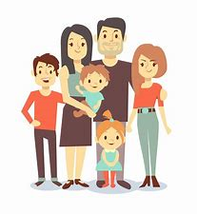
Solution Focussed Approach
Questioning Approach – not an expert approach
Strengths – everyone / every system has them
Goals – all helping activity is aimed at moving the client towards the goal
Change – is constant
Identify what’s working or has worked in the past & amplify it
Can be quick – small change can spiral into big change
Full knowledge of cause unnecessary – opposite of an expert, problem-focused approach
There is no one ‘right’ viewpoint; we don’t have to agree on problems to be able to work together

Slide 4
Solution Focused Questions
Goal focused questions e.g. the ‘Miracle’; concept of the ‘preferred future’
Relationship questions
Scaling questions
Exception questions
Strengths / past successes questions
Coping questions – “How do you do it?”
Notes:
We are going to be going into these in more detail as the training progresse:
Miracle question – imagine you wake up tmrw and all your worries have gone – what would life look like?
Relationship questions – so what do you think your brother would say youre good at /what do you think your mum would say you are best at when you are looking after the kids
Tell me about a time when you were stressed but you managed to cope with the chidlren and get them to school on time?
What did you value the most from the help which your friend Sue gave you when you felt down last week.

Slide 5
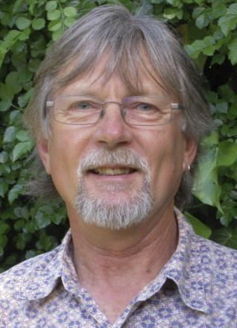
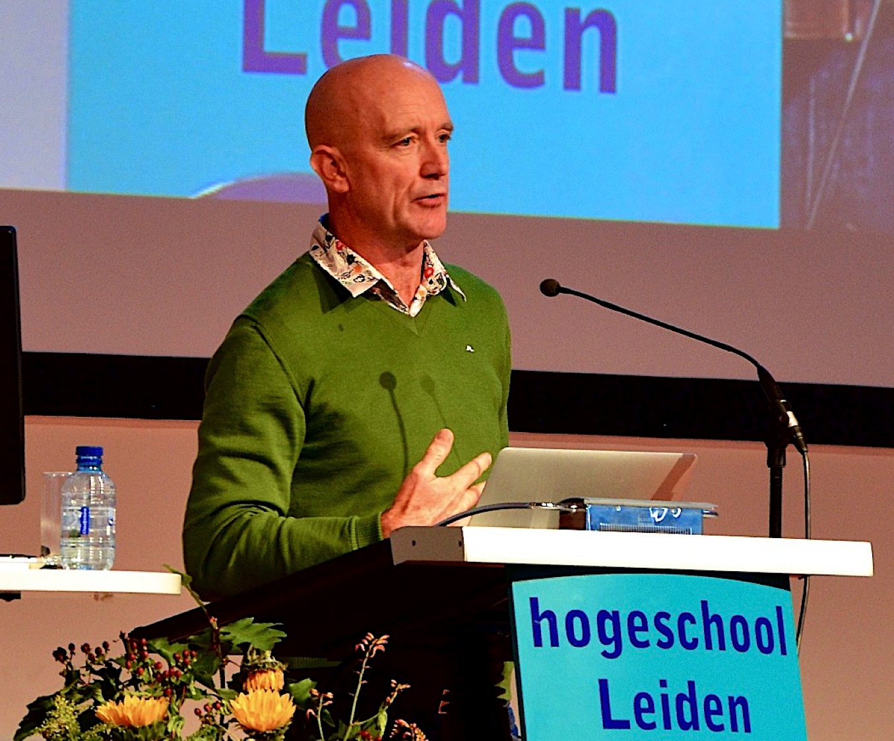
History of Signs of Safety
Steve Edwards & Andrew Turnell Collaboration 1993 with 150 Practitioners
Interested in how SFBT fitted with Child Protection Work.
“If workers use the ideas, they are in the model; if they don’t they’re in the bin”
Build from family strengths
Always consider the possibility
you might be wrong
Honest and straight but hugely
kind – generate hope
Partnership and collaboration – respect and co-operation
Relationships at the centre
Child focused, family oriented
Clear communication & expectations – plain language
A QUESTIONING APPROACH
5
Notes:
These are the co founders of SOS – Steve Edwards and Andrew Turnell from Australia. Steve Edwards is now retired but Andrew Turnell is still actively involved in SOS
They were interested in how SFBT could fit into child protection case work.
They were interested in how to work more effectively with families who don’t want to work with you
It was developed in the late 80’s early 90’s; Steve was a frustrated social worker and Andrew was working as a family therapist
They were both working with similar families but using different approaches – Steve felt he was being very oppressive towards families and didn’t have an approach to working with difficult families and Andrew was using a very empowering and enabling approach, using a questioning approach
They collaborated together to look at how to improve frontline social work and stop it being so oppressive
So they developed this model which has partnership and relationships at the centre. They stepped out of oppressing families and moved into an enabling and empowering approach with relationships at the centre.
They developed the model by talking to social workers about what was working and what wasn’t and using this consultation process to shape the model – this is still an evolving process today. “If workers use the ideas, they are in the model, if they don’t they are in the bin”
The model is not about preserving families at all costs – its about giving families and their naturally connected networks the opportunity to bring about
their own solutions and to help themselves. We are still rigorous in our approach to child safety – but at the same time children belong to communities of
people and we have to work with these communities to support them to make change. Often we end up working with single mothers – we need to move
away from this and look for networks and families and friends around that child.
We do this through collaboration and partnership and asking families to bring their own solutions rather than telling them what to do. Practice from a stance of humility – there are some things we don’t know – this creates a context where cooperation is more likley
We also do this by using plain language and move away from jargon speech – we are so used to talking about emotional harm in meetings – we need to move away from this towards: “last week when you threw a cup against the wall – Billy was really scared” or “were really worrried about the time you two fight and its made the children upset, scared and anxious if they carry that with them and it may affect them in school or may use violence themselves when they’re older.
But you need a relationship to do that
Service users are the experts and they know their families better than we do. We use a questioning approach with families and their naturally connected people to bring about their own solutions rather than telling them what to do. We have to ask good questions and move away from identifying problems and commissioning services to fix those problems.

Slide 6
Experiencing the Framework
Think about a child/teenager in your life who has a problem you are worried about.
(A child or young person other than someone you are working with)
6
Notes:
We are now going to introduce you to the framework
You are going to experience using the assessment and planning framework for yourselves.
You will need a piece of paper and a pen!
You will need to think about s child or a teenager in your life who has a problem or who you are worried about.
Not someone you are working with,

Slide 7
Thinking about a child/teenager in your life that you feel a worried about:
What are you Worried About?
What’s Working Well?
What Needs to Happen?
STEP ONE: START HERE, BACK AND FORWARDS
STEP THREE
What has happened, what have you seen, that makes you worried about this child/teenager?
What do you like about ___ what are his/her best attributes?
Having thought more about this problem now, what would you need to see that would make you satisfied the situation was at a 10?
Who are the people that care most about ___? What are the best things about how they care for ____?
What words would you use to talk about this problem so that ____ would understand what you’re worried about?
What would ___ say are the best things about his/her life?
What would ___ need to see that would make them say this problem was completely sorted out?
When you think about what has already happened to ____ what do you think is the worst thing that could happen to ____ because of this problem?
Who would ___ say are the most important people in his/her life? How do they help ___ grow up well?
What do you think is the next step that should happen to get this worry sorted out?
Have there been times when this problem has been dealt with or was even a little better? How did that happen?
Are there things happening in ____’s life or family that make this problem harder to deal with?
On a scale of 0 to 10 where 10 means this problem is sorted out as much as it can be and zero means things are so bad for the young person you need to get professional or other outside help, where do you rate this situation today? (Put different judgment numbers on scale for different people e.g., you, child, teacher etc).
0
STEP TWO: JUDGEMENT
10
Notes:
This is the framework in its most basic form – you will see as we go through this exercise how we use a questioning approach to fill it in and to organize our thinking.
There are 3 steps in the process, we are going to be going back and forwards in the columns – I’m going to ask you at the end about the process no the content.
2. You’ve just done a mapping !
How did the process feel? What struck you about the process?
Feels different on a personal level so remember and hold on to it.
Empathy – we get to experience how things feel for the child
Cross stitching – balances the concerns with the strengths
Importance of questions – and asking good ones
Open questions
Language is simple and straightforward – no jargon
Should slow down your thinking, allow you to take a step back,
Gives you the whole picture – rather than solely focused on harm – when you do this parents are more likely to talk and open up

Slide 8
Thinking about a child/teenager in your life that you feel a bit worried about:
What are you Worried About?
What’s Working Well?
What Needs to Happen?
STEP ONE: START HERE, BACK AND FORWARDS
STEP THREE
What has happened, what have you seen, that makes you worried about this child/teenager?
What do you like about ___ what are his/her best attributes?
Having thought more about this problem now, what would you need to see that would make you satisfied the situation is at a 10?
HARM
Existing
Strengths
FUTURE
SAFETY
Who are the people that care most about ___? What are the best things about how they care for ____?
What words would use to talk about this problem so that ____ would understand what you’re worried about?
What would ___ need to see that would make them say this problem is completely sorted out?
What would ___ say are the best things about his/her life?
When you think about what has already happened to ____ what do you think is the worst thing that could happen to ____ because of this problem?
DANGER
Who would ___ say are the most important people in his/her life? How do they help ___ grow up well?
What do you think is the next step that should happen to get this worry sorted out?
Next Steps
Existing
Safety
Complicating
Factors
Has there been times when this problem has been dealt with or was even a little better? How did that happen?
Are their things happening in ____’s life or family that make this problem harder to deal with?
Animations Off
On a scale of 0 to 10 where 10 means this problem is sorted out as much as it can be and zero means things are so bad for the young person you need to get professional or other outside help, where do you rate this situation today? (Put different judgment numbers on scale for different people e.g., you, child, teacher etc).
0
STEP TWO: JUDGEMENT
10
Notes:
In child protection we have sub headings
Harm:
Is what has actually taken place to harm the child
Complicating Factors:
The things which make it difficult to get the concerns sorted out
Housing, poverty, mental health – these do not constitute harm
Danger Statement:
Statement about the future harm to the child
Using plain language
e.G we’re really worried about mum and dad fighting and dad called mum a bitch and slammed the door and Billy was crying and that this has happened a few times now, and we know that this is affecting Billy in school, he has started swearing himself and fighting more in the playground.
Understanding is more important than agreement.
DS are pivotal in the approach – they describe worries in the simplest way, making it accessible
It takes time, its not easy – easier to use jargon
Middle column: the seeds of the solution lie in the middle column, as much as want to know about harm – we want to know what the family are doing well.
We want to find out about postives I the family generally - these are existing strengths
We also want to find out about the things the family are already doing to reduce the harm – this is existing safety.
Things people are doing to stop or reduce the harm, dig into it using questions.. Tell me about that time you were going to take drugs but you didn’t because you were looking after the kids..what was happening, what was different
Last Column: what is our destination?
Opposite side of the coin to the DS
We want to develop safety goals – when is it safe enough to close the case? What will parents be doing and what will the children present like?
This is not about resources!
Describe what you want to get to before you set off.
Existing strengths -

Slide 9
Thinking about the child/teenager and the family situation in this case:
What are we worried about?
What’s working well?
What needs to happen?
Harm/Key Worries
Existing Strengths
Safety/Success Goals
Danger/Worry Statements
Existing Safety/Success
Next Steps
Complicating Factors
On a scale of 0–10 where 10 means the child/teen is safe enough and we can close the case and zero means things are so bad for the young person we must remove them into care immediately, where do you rate this situation today?
Put different judgement numbers on scale for different people, e.g. different professionals, child, parents etc.
0
10
Notes:
As per slide.

Slide 10
Thinking about the child/teenager and the family situation in this child protection case:
What are we worried about?
What’s working well?
What needs to happen?
HARM: Things that Mums or Dads or people looking after your child do that hurts or really scares him or her.
EXISTING STRENGTHS: Those things that mum/dad/others in your child’s life are really good at and that make your child feel safer at home.
SAFETY GOALS: The things the we need to see happening to be sure your child is always safe particularly when life gets hard. Once you know what we need to see (to get out of your life), we’re going to ask you to come up with you best ideas about who can do what to show everyone the child is safe . . .
Sometimes it’s what the adults don’t do, like forgetting to give the child the food they need or not getting them to school.
EXISTING SAFETY: Things mum/dad/others already do that make sure your child is safe and okay at home even when things get difficult or dangerous . . .
DANGER: This is what we’re scared will happen to the child if nothing gets better or changes.
NEXT STEPS: The next one or two things we need to do to move one or two points up the scale.
Complicating Factors: Things that happen in the family or around the child that make make it harder to make sure the child is always safe and looked after like he/she needs . . .
0
10

Slide 11
Signs of Safety Success Assessment and Planning Form
What are we Worried About?
Whats Working Well?
What Needs to Happen?
Harm Worrying Behaviours
Existing Strengths
Safety Success Goals
Existing Safety Success
Danger Worry Statement
Complicating Factors
Next Steps
Wellbeing Scale: On a scale of 0 to 10 where 10 means I am fully confident that things are going pretty well for the child / young person in all aspects of their life and they don’t need additional help, support or key changes in what they are doing or how they are being brought up; and 0 is we have very serious worries that things are going badly off course in the young person’s life in one way or another and some action to change things is certainly needed , where would you rate things today?
0
10

Slide 12
SIGNS OF SUCCESS – Healing Connection & Belonging Framework
What are we worried about?
What’s working well?
What needs to happen?
HARM: Past hurt, injury, abuse and trauma experienced by the child. Loss of contact / connection / belonging / identity through separation from network. Ongoing loneliness and grief. Absence of unconditional love and commitment. Insufficient positive, active, demonstrated love and support
DANGER: The harm or hurt that is believed likely to happen to the child if nothing changes.
COMPLICATING FACTORS: Actions and events in and around the family and child and by professionals that make it more difficult to deal with the problems.
EXISTING STRENGTHS: People, plans and actions that contribute to a child’s wellbeing.
EXISTING SUCCESS: Healing, connection and belonging: things network members are doing which is making the child heal, connected, belong, keep a strong identity, loved and cherished; network ‘dosing’ – daily small and great acts of love, kindness, support, liking, fun, praise, cherishing which feeds the soul.
SUCCESS GOALS: .What the network needs to see to be convinced that the child is well connected, strongly belongs, healing from past trauma and thriving.
NEXT STEPS: The immediate next actions that will be taken to build future safety.

Slide 13
Why is network important?
Our CICC and Care leavers tell us it is!
All children will have a SOS Support/Safety Network which includes all the people that are important to them and who can help them to sort out the worries. DOES YOUR CHILD HAVE A SUPPORT/SAFETY NETWORK? “I want to stay connected to the people who are important to me” (Anon aged 12)
Tameside Practice Standards 2022

Slide 14
Why is network important?
The more healthy relationships a child has, the more likely he or she will be to recover from trauma and thrive. Relationships are the agents of change and the most powerful therapy is human love.”
Bruce D. Perry

Slide 15
Family Finding – Kevin Campbell
A meaningful connection to their family or network helps a child develop and maintain a sense of belonging
Every child/parent has a family and/or network and they can be found if we try
The single factor most strongly connected with positive outcomes for children is a meaningful lifelong connection to their family and/or network
Safety is temporary without healing. Healing happens in the network or group

Slide 16
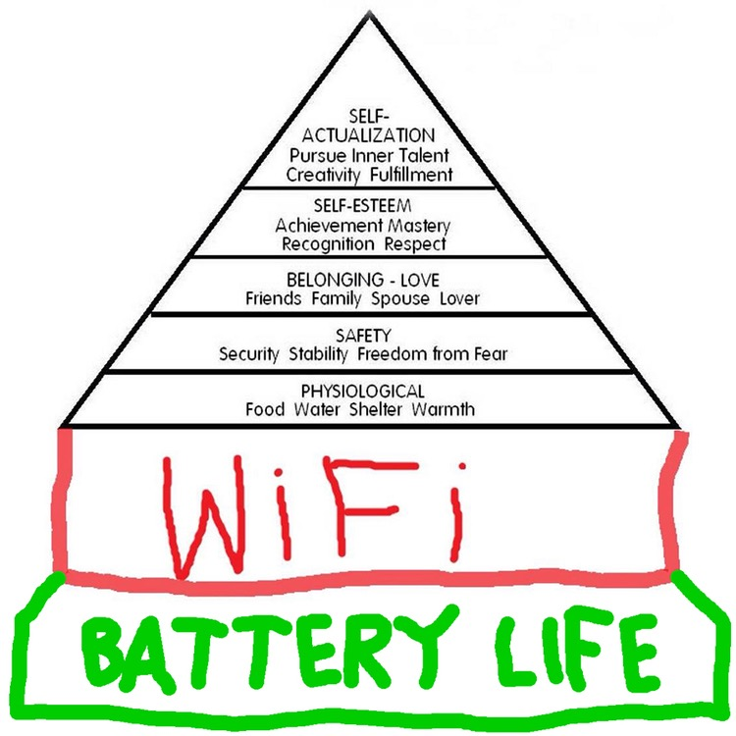
The Child’s Journey – What is Our Destination?
“I don’t want to just survive –
I want to live”
Lemn Sissay (2016)

Slide 17
Network and Practice
It is one of the first things we ask about at the front door, in our initial visits and we keep asking about it when a child become looks after
It is set out in our practice standards
When parents/carers say they have no one in their naturally connected network, we sensitively but persistently ask questions to explore this further, use the ‘family finding’ tools and work with parents/carers to help develop the informal network of support around the family/carers/placement

Slide 18
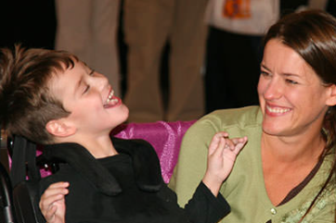
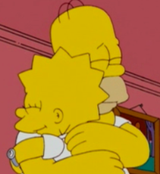
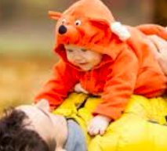
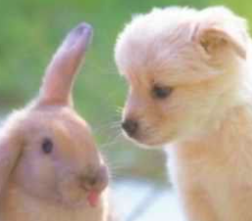
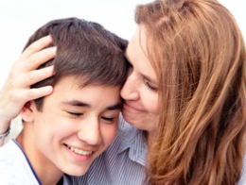
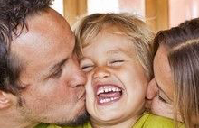
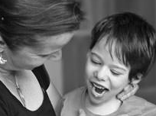
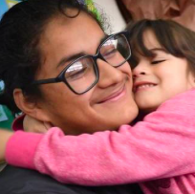
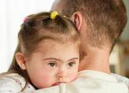
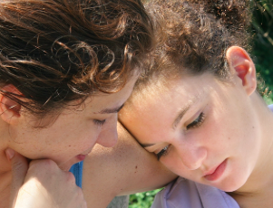
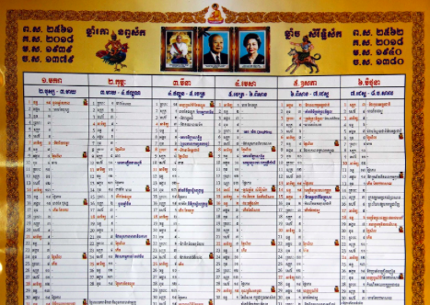
Building & Supporting Networks
No. 6 Love and Care Calendar – ‘Dosing’

Slide 19
Dosing
Children getting lots of ‘positive strokes’ – ‘dosing’ – each day by those around them have much longer telomeres – they have good allostatic balance.
Children with adverse experiences (4 plus ACEs), experienced/ing toxic stress and trauma, come from tough social backgrounds and getting very little dosing – very short telomeres – allostatic overload.

Slide 20
Calendaring – Measuring Dosing
Monday | Tuesday | Wed | Thurs | Friday | Saturday | Sunday
Breakfast To School | Breakfast To school | Breakfast To school | Breakfast To School | Breakfast To school | Breakfast | Breakfast
Lunch | Lunch | Lunch | Lunch | Lunch | Lunch | Sunday Lunch
Home & Tea | Home and Tea | Home & Tea | Contact with Dad | Home and tea | Tea | Contact with brother
 |  |  | Home and tea | Cinema |  | Tea
Bed | Bed | Bed | Bed | Bed | Bed | Bed

Slide 21
Calendaring – Measuring Dosing
Monday | Tuesday | Wed | Thurs | Friday | Saturday | Sunday
Breakfast To school | Breakfast To school | Breakfast To school | Breakfast To school | Breakfast To school | Break fast | Breakfast
Computer Club |  | Drama group | Cycling club |  | Riding Lesson
Lunch | Swim Prac Lunch | Lunch | Lunch – cinema club | Swim Prac Lunch | Lunch | Sunday Lunch
Gym club | Chess Club | Grandma - allotment | Cousins coming for tea |  | To town with Ellie | Family walk
Home and tea | Ellie coming for tea | Grandma’s for tea | Home and tea | Straight to Jane’s - sleepover | Tea | Tea
Molly’s - homework |  |  |  | Cinema | TFI Friday’s for J’s b’day
Bed | Bed | Bed | Bed | Bed | Bed | Bed

Slide 22
Who Is Looking After Amara?
Education & Skills
Food & Nutrition
Amara
Emotional & Social
Shelter & Care
Health
Protection

Slide 23
-
Who Is Looking After Amara – Emotional & Social?
Friends & Relationships
Talking & Listening
Amara
Love & Praise
Love & Praise
Learning Family things
Having Fun

Slide 24
Love & Care Calendar
When Is It Happening?
Monday | Tuesday | Wed | Thurs | Friday | Saturday | Sunday
Where are the gaps?
How can the Network fill in the gaps?

Slide 25
Botum Mother
Akraa Father
Amara

Slide 26
Case examples
Why is signs of safety important for the children we work with?

Slide 27
Understanding the lived experience
Signs of Safety supports professionals to understand who is around the child and who the child thinks is important
The people around a child have a huge impact on their day to day life
Children in care experience more changes in their network than children who live at home
Networks include people who aren’t formally linked to a child
Networks may not be visible, eg keeping in touch online
It is important for these relationships to be acknowledged

Slide 28
Case examples
Child C spent three months in hospital
During this time, child C saw:
- Care staff who spent time on the ward
- Mental health liason staff who visited daily
- A psychiatrist who visited weekly
- Nursing staff
- Medical consultant
- CAMHS

Slide 29
The most important people to the child:
- Three security staff who took them for walks and who they chatted to most
- Other children on a ‘kids in care’ tictoc thread
- Two friends from school who visited one evening

Slide 30
Success goals and success plans
Signs of Safety includes clear goals for children
Many children feel frustrated at the focus on what they’ve done ‘wrong’
Children in care can feel past difficulties follow them from home to home
Having defined goals to talk about in meetings helps to focus on a child’s strengths and aspirations
Where there are vulnerabilities, Success plans can keep things in perspective for children who have had traumatic pasts

Slide 31
Child D had moved from a secure setting to a home in the community
Their day to day network included:
Boxing coach, a street pastor, an older friend they’d met in the area, an uncle they’d re-connected with, along with 3 or 4 specific members of care staff
Child D’s family were important to him but the above network were who he wanted to help in a crisis
Child D had a history of being exploited. Child D didn’t want to give details of friends because he was used to police ‘kicking doors in’ looking for him. Child D felt they weren’t vulnerable because ‘its nothing like when I was 12’

Slide 32
Child D’s goals and safety plan
Child D’s goals – to have a phone to be able to chat up a girl and take their number ‘like a normal person’
To be allowed money in hand daily
To be allowed to go out long enough to go to gigs without adults with him
To have friends who weren’t part of ‘the system’
These goals were made central in his Cared for Child review and care plan

Slide 33
Child D’s success plan included:
Child D agreed to have a phone and take it with them and answer it, on agreement that the police wouldn’t be asked to trace the call (absolute emergencies/escalation examples were defined and agreed with D)
Child D agreed to keep receipts for what he spent his money on the first few weeks
It was agreed that a scale would be used for how risky child D’s missings were, so he trusted that being late for curfew didn’t ‘go against him’ as being missing overnight would be

Slide 34
Feedback from Child D
I’m going to trust people when I trust them, not because of their qualifications
The staff stuck to what they’d said; if I missed the call they’d wait 20mins for me to ring them back. In the past people would ring the police if I didn’t pick up. Friends didn’t want to know me because the police would be at their door, when I could have just not heard my phone
Before, if I went missing for a day I may as well go for a week cos I either didn’t have anything, or everything would be taken off me anyway. Now I can make a mistake and still have a life. They let me learn from it.

Slide 35
Conclusion
Child is central
Strengths based approach – success goals
Network is important
Plans – with the child/young person and include their network
Aspirational
Belonging and healing

