Slide 1
Tameside Placements Provider Briefing
Provider Forum July 2021

Slide 2
Sufficiency position entering covid
Tameside makes a greater use of residential to meet needs of population, 4th highest purchased in NW, 2nd in GM. Linked to historic increase in the number of children we care for and a lack of foster families locally and nationally.
We can not always find the right placement close to home
Some children have too many placement moves,
Projected increases in demand for leaving care services due to current age profile of care for children.
Increasing use of spot purchase services for care leavers
Growth in IFA capacity has stalled and there are not enough foster carers

Slide 3
Children’s Home Placements
Need to support more children properly living with families, but residential will continue to be an important part of landscape
Increased the size of internal children’s homes in covid
Opening a new assessment hub and a respite home
Purchased residential services will continue to be part of the offer for our children
Want to place more children closer to home and have been working with local homes to try and increase this
The number of children placed outside of either Tameside, a neighbouring authority, or Greater Manchester has increased by 4% - some of our children live too far away

Slide 4
Tameside local residential homes
5 local authority homes and 14 homes operated by private sector (no voluntary sector homes in Tameside)
80 beds in total
Average size of the private homes 4.6 beds. Largest in GM and compared to GM average 3.5
No solo provision
13 organisations run the 14 homes. Range from small local companies, to the largest national suppliers
Keen to discuss new service models and provision which will meet the needs of our children
Can not generally take our most complex children

Slide 5
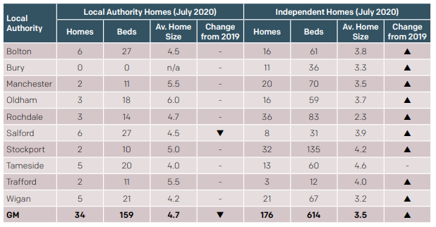
Wider GM Context

Slide 6
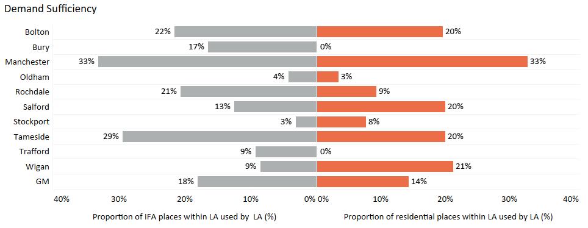
Placing Locally

Slide 7
Key challenges in residential
Services are needed which can:
Deliver high quality and support our children
Support older teenagers. Very challenging to find properly registered provision which can support vulnerable 16 and 17 years olds. Relying on CQC registered services in some instances.
Support young people on DoLS
Supporting our children to move effectively on to live with families when they are ready
Effectively prepare young people for independence
Stick ability when things are tough
Work with Tameside to take our children and work together to deliver for them
Tell us proactively when you are getting vacancies and forward plan

Slide 8
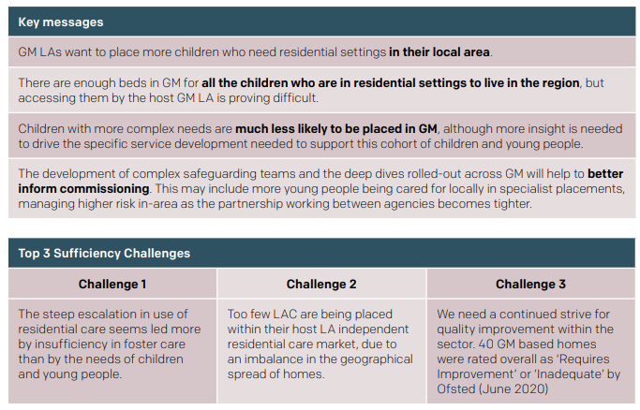
Wider GM Sufficiency Challenge https://greatermanchester-ca.gov.uk/media/3849/gmca_childrens_sufficiency_strategy_20-22_final.pdf

Slide 9
Supported and Independent Living
Important to be on Placements North West FPS
Demand for services increasing as our children age
Quality services are important, the NW FPS raised the bar on training and in other areas.
National standards are coming and providers must be ready.
With more of our children in residential than is typical, we will need good quality supported accommodation to help them transition to independence
New homes and services have opened during covid
Tameside has developed transition support service which has increased to 17 beds. Looking at how to further increase capacity. Accommodation a key strategic focus.

Slide 10
Supported and Independent Living
Need for more providers who can offer floating support and accommodation where young people can maintain tenancy post support.
Good working relationships for placement finding supporting local placements
An area of focus for the coming year, particularly want to understand the provide base better and how it’s changing
There may be a need for more floating support (without accommodation) options, more information to follow on this if appropriate.
Developing thematic sessions for SAILS providers in Tameside to look together at quality and practice to support our children
Vital providers work with the local community to build relationships

Slide 11
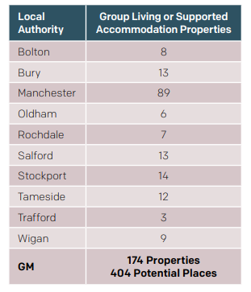
SAILS: Group Living Properties (2020)

Slide 12
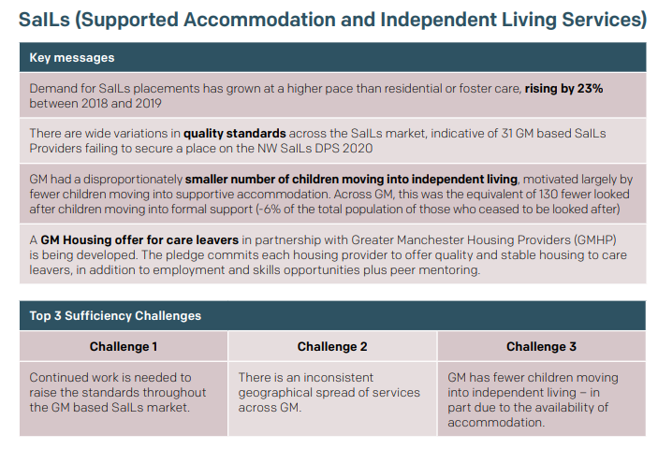
Wider GM Sufficiency Challenge https://greatermanchester-ca.gov.uk/media/3849/gmca_childrens_sufficiency_strategy_20-22_final.pdf

Slide 13
Fostering
There are not enough foster carers in Tameside.
Investment in internal fostering services, recruitment and the foster carer offer
The number of IFA families has been maintained in Tameside, but growth is needed.
There are children living too far away and some in children’s homes because we could not find the right families for them
Tameside does better than most GM LAs in placing children locally, but there are almost as many children from Manchester living in IFA as from Tameside.
As early notification as possible when local placements are available
Long term placement finding / matching increasingly possible
Tameside has invested in it’s approaches to permanence. With long term matching practice improving, and an area of strategic focus.
Services needed for the same cohorts of children as many local authorities:
Sibling groups
Older children
Children who have more complex needs
Good carers who are well supported and can stick with our children

Slide 14
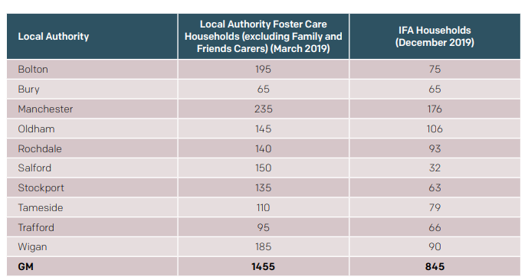
Fostering Capacity
Data is pre pandemic, but early indication of 2021 data is similar IFA figures for Tameside and no net decline in GM

Slide 15
Enhanced and long term matching of foster carers
Tameside has more children in residential than is typical and some of those children are ready to live with families with the right support.
The number of children we have effectively stepped down from residential to live with the right family has increased in the last 18 months
Using the Enhanced Fostering Category on FPS
Matching over many weeks or even months to help find our children who are in residential the right family and support for them. Currently a number identified
Have recently stepped our first child down from residential using this approach.
Multi-week planning, including retainers, bespoke transport, additional funding for support to child and foster carer
Keen to look at longer term matching for more children, being managed separately from routine brokerage to allow for focus and change of pace
Nick.Ellwood@tameside.gov.uk for IFAs who can put forward carers

Slide 16
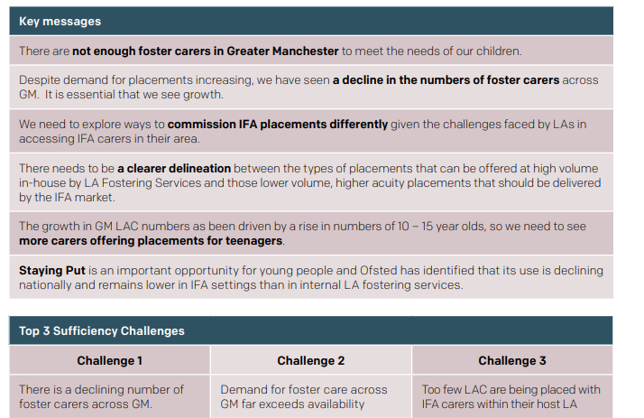
Wider GM Sufficiency Challenge https://greatermanchester-ca.gov.uk/media/3849/gmca_childrens_sufficiency_strategy_20-22_final.pdf

Slide 17
Brokerage & Monitoring in Tameside
Lots of work over last 18 months to improve the processes and way we work to find and monitor placements. This is ongoing
Additional investment for more capacity has been agreed and this will improve further the work we do with providers and accelerate ongoing improvement programme
Will increase joint working, constructive challenge, accountability and support to placements.
Will support focus on objective of supporting more children living successfully with families, and placing more of our children in Tameside.
New manager started in May 2021 Julie Wilkinson
Language of care work coming, our children don’t want us to use some of the terms which are common place. Will mean changes in titles and some documents as we move forward.

Slide 18
Q&A

Slide 19
Brokerage and Monitoring Discussion
Julie Wilkinson,

Slide 20
Challenges

