Slide 1
Meet the Local Offer in Tameside
Tim Bowman, Assistant Director of Education
Louise Rule, Education Programme Lead
Charlotte Lee, Population Health Programme Manager
Philippa Robinson, Children’s Commissioning and Development Manager
30th July 2020
Notes:
Tim

Slide 2
Introduction/ Setting the Scene
SEND Joint Needs Assessment
SEND Strategy
Purpose of today’s webinar - Local Offer – Past, Present, Future
Notes:
Tim

Slide 3
What is the Local Offer?
Local authorities must publish a Local Offer, setting out in one place information about provision they expect to be available across education, health and social care for children and young people in their area who have SEN or are disabled, including those who do not have Education, Health and Care (EHC) plans.
The Local Offer has two key purposes:
• To provide clear, comprehensive, accessible and up-to-date information about the available provision and how to access it; and
• To make provision more responsive to local needs and aspirations by directly involving disabled children and those with SEN and their parents, and disabled young people and those with SEN, and service providers in its development and review.
Notes:
Louise

Slide 4
What is the Local Offer?
The Local Offer should be:
collaborative: local authorities must involve parents, children and young people in developing and reviewing the Local Offer. They must also co-operate with those providing services.
accessible: the published Local Offer should be easy to understand, factual and jargon free. It should be structured in a way that relates to young people’s and parents’ needs (for example by broad age group or type of special educational provision). It should be well signposted and well publicised.
comprehensive: parents and young people should know what support is expected to be available across education, health and social care from age 0 to 25 and how to access it. The Local Offer must include eligibility criteria for services where relevant and make it clear where to go for information, advice and support, as well as how to make complaints about provision or appeal against decisions.
up to date: when parents and young people access the Local Offer it is important that the information is up to date.
transparent: the Local Offer should be clear about how decisions are made and who is accountable and responsible for them.
Notes:
Louise

Slide 5
What must be included in the Local Offer?
Local authorities must include information about all the areas specified in the Special Educational Needs and Disability Regulations 2015.
The Local Offer must provide information, as outlined by the SEND Code of Practice (2015) including, but not exclusive to:
Educational, health and care provision
Transport
Community support
Support available to children and young people to help them prepare
for adulthood
Information about how to seek an EHC needs assessment
Notes:
Charlotte

Slide 6
Why have a Local Offer?
Not only because it is a Legal requirement, but because:
A co-produced Local Offer enables a new relationship between public services and service users/residents
Enables us to recognise and build on the strengths within our communities
Supports the wellbeing and quality of life
Supports prevention and early intervention
Supports the need to reduce inequalities
And it is the right thing to do!
Notes:
Charlotte

Slide 7
Tameside Local Offer – the past
As part of the annual review of the Local Offer in 2019, families told us that:
The pages are not easy to navigate The pages are too busy There are too many choices Information is out of date We can’t find what we are looking for We would rather “just phone OKE or support group”
Notes:
Philippa

Slide 8
Tameside Local Offer – the present
Worked with partners to:
Give the Local Offer a different look and feel
Updated information where we can
Rethought the navigation – wearing a different hat
Linked to other LA Local Offers
Notes:
Philippa

Slide 9
Tameside Local Offer – the present
Interactive Activity:
Take 5 minutes to look at the Local Offer yourself.
https://www.tameside.gov.uk/localoffer
Can you find information about your service? Do you think it is friendly for the intended audience.
If you was a young person or a parent of a child with SEND, what would you think? What would you like to see?
REMEMBER: Don’t click off Skype ☺
Notes:
Tim

Slide 10
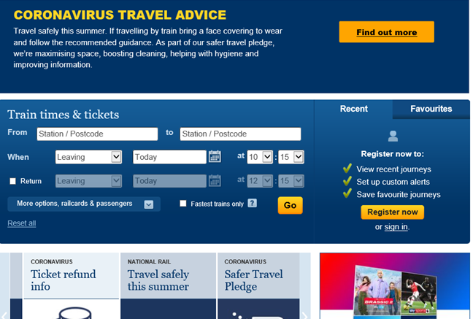
Tameside Local Offer – the present
Some pages are interactive and easy to navigate
Notes:
Philippa

Slide 11
Tameside Local Offer – the present
But that is not enough:
Some of the pages are text heavy and not easy to read.
Notes:
Philippa

Slide 12
Tameside Local Offer – the future
We need everyone to take ownership of their information on the Local Offer.
We need the information that people own to be understandable and accessible for the audience – have a look at the Council for Disabled Children website.
We are looking for Local Offer Champions across the Services and Organisations – are you interested? Email: local.offer@tameside.gov.uk
Notes:
Tim

Slide 13
Next Steps
Children, young people and families will review the Local Offer in the coming weeks.
We need Services to review their information – update and make it accessible and friendly for the audience. This is where we need our Local Offer Champions.
Launch and comms plan.
Notes:
Tim

Slide 14
References
Special educational needs and disability code of practice: 0 to 25 years Statutory guidance for organisations which work with and support children and young people who have special educational needs or disabilities (2015):
https://assets.publishing.service.gov.uk/government/uploads/system/uploads/attachment_data/file/398815/SEND_Code_of_Practice_January_2015.pdf
Special educational needs and disability pathfinder programme evaluation (2014): https://assets.publishing.service.gov.uk/government/uploads/system/uploads/attachment_data/file/380110/RR429A_-_Evaluation_of_the_SEND_pathfinder_programme_local_offer.pdf
Notes:
Tim

Slide 15
Close
Any questions, please email: local.offer@tameside.gov.uk
Notes:
Tim

