Slide 1
Ageing Well with Dementia in TAMESIDE & GLOSSOP
Chris Pimlott – Mental Health and Learning Disabilities Commissioning Manager

Slide 2
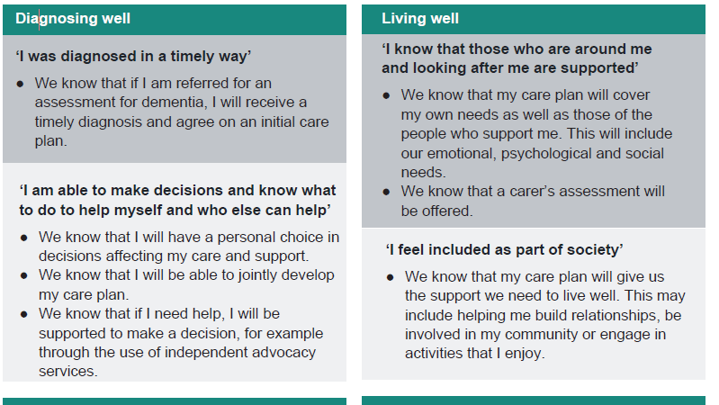
The Greater Manchester Plan

Slide 3
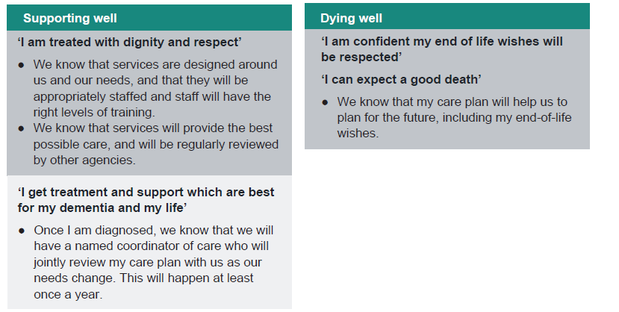
The Greater Manchester Plan

Slide 4
What we do well
Diagnosis rates
Recorded rates – 2097
Estimated rates – 2530
Percentage – 82.0
England average 68.7%
North of England 73.2%
NHS England North (Greater Manchester) – 76.9%

Slide 5
What our ambitions are
An integrated dementia pathway
Co-produced with experts by experience and carers
A rich post diagnostic support offer
Enabling people to make informed choices about their end of life care

Slide 6
What is available in Tameside and Glossop?
The Tameside and Glossop Memory Clinic
Health and Wellbeing College
Be Well Tameside
Alzheimer’s Society Dementia Support Worker
Age UK Dementia Support Service
The Shed
Mottram Movies
Live Active
Active Medlock – Droylsde
Walk and Talk – 30 minutes
Live well Tameside
Walking for health

Slide 7
Social groups, dementia cafes and peer support
Alzheimer’s Society Dementia Support Group
Forget me not buddies
Denton Dementia Café
Forever Friendship Café
Dementia Well Being Group
Willow Wood Hospice Dementia Support Café

Slide 8
What next?
Listen
Learn
Improve
Strategy
Integration
Local Voice
MCI

