Slide 1
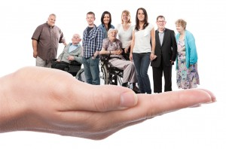

Personal Independence Payment
What it is and How to claim it.

Slide 2

What is Personal Independence Payment?
Personal independence payment is called PIP for short
A new type of Benefits money
To help disabled people pay for the extra things they need because of their disability
For people age 16 to 64
It is instead of Disability Living Allowance (DLA)

Slide 3
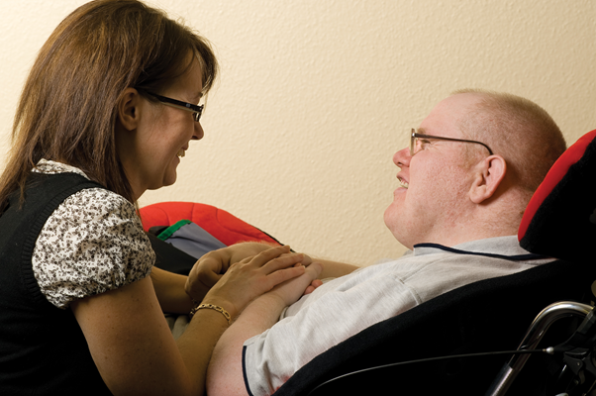
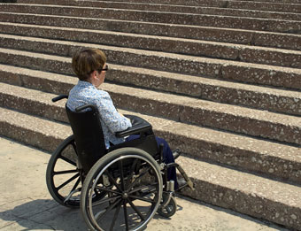
PIP has two parts
Help with daily living
Help with mobility

Slide 4

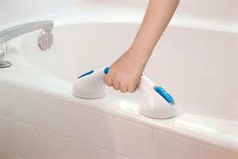
What is Daily Living?
Daily living activities include
  Preparing food
  Eating and drinking
  Washing and bathing
  Getting dressed and undressed
  Communicating
  Mixing with other people
  Making decisions about money

Slide 5
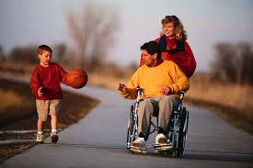
Mobility
Moving Around
Going out

Slide 6

I get Disability Living Allowance
You cannot get DLA and PIP at the same time
You will stop getting DLA some time in the future.
You can claim PIP instead.
The DWP will write to you about this.
You don’t have to do anything until the DWP write to you.

Slide 7


When do I have to claim PIP?
When your DLA runs out.
After your 16th birthday
If you tell the DWP about a change in the help you need because of your disability.
When the DWP write to tell you your DLA is stopping.

Slide 8

How do I claim PIP?
You have to phone the PIP Claim Line.
You can ask someone to call for you, but you must be there too.
You will be sent a form to fill in and post back.
Most people will be asked to see a health worker. You can take someone to the appointment.

Slide 9
What happens next?
The DWP will write to tell you how much you can get.
Your DLA will be paid until you get your PIP decision.
If you are not happy with your PIP decision, you can appeal.
The Welfare Rights Service can help with your appeal.

Slide 10
Tameside Welfare Rights and Debt Advice Service
Telephone Number
0800 074 9985
Monday and Wednesday 9:30 to 12:30
Website
www.tameside.gov.uk/welfarerights

